Slide 1

Data-Mining Report
By: Luis Lavat, Lucas Sanchez, & Leyton Lewis

Slide 2
Table of Contents
Executive Summary
Data Cleaning
Goals of our Analysis
Queries/Visualizations
Conclusion
Notes:
Leyton

Slide 3

Executive Summary
Time series data, containing 53 rows and 26 different variables
Team data, game data, financial data
Data is collected from 1967 - 2018 (Super Bowl I - Super Bowl LII)
Variables Analyzed (numerical vs categorical):
Numeric: SB, avg_us_viewers, ad_cost, attendance, winning_pts, losing_pts, combined_pts, difference_pts, Win_Count, Year.
Categorical: Name, MVP, Position, Conference, Division, network, date, venue, city, state, qb_winner_1, coach_winner, team_loser, coach_loser, avg._ticket_price, inflation_adj.
Notes:
Leyton

Slide 4
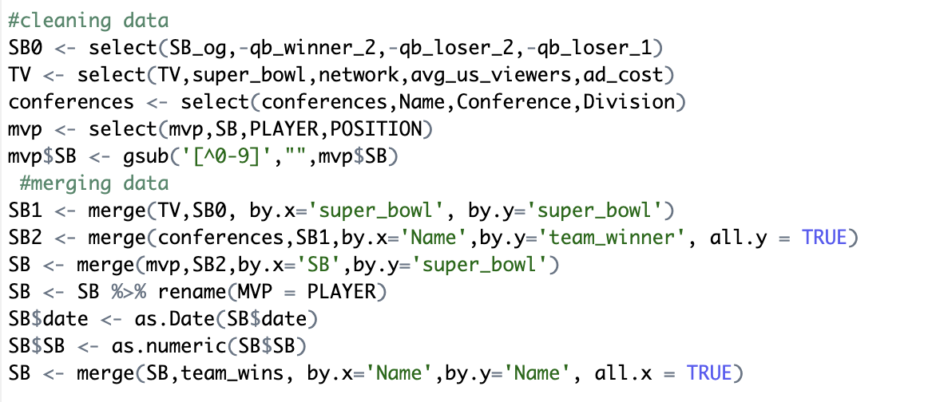
Data Cleaning
Started with 4 different data sets, ended with 1
Got rid of duplicate variables
Filtered variables to just what we wanted
Parsed data for unwanted characters
Created some of our own variables
Merged data sets based on team names and superbowl number
Converted variables from characters to numeric/date
NFL teams that changed names resulted in NA
Manually imputed ticket prices
Notes:
Lucas

Slide 5

Goals of our Analysis
Goals:
Analyze the data to find correlation trends between different variables
Determine what franchises have dominated historically
Create visualizations that demonstrate the evolution of the sport
Discover financial trends to draw conclusions about the rise or fall of the NFL's market value
Notes:
Leyton

Slide 6
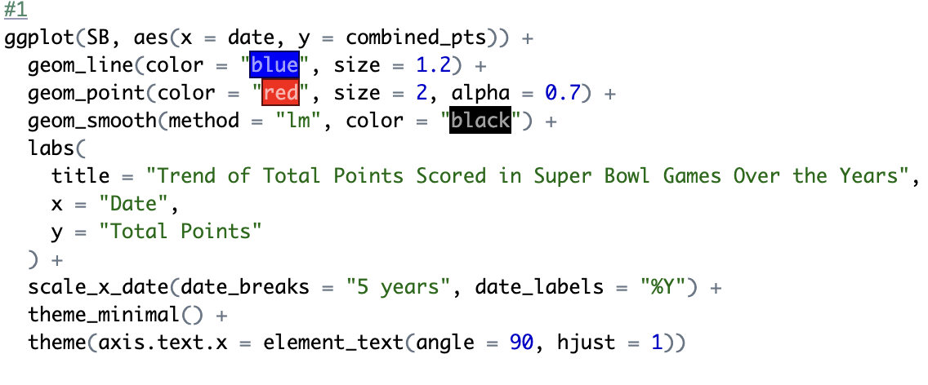
Query 1: What is the trend of total points scored in Super Bowl games over the years?
Notes:
Leyton

Slide 7
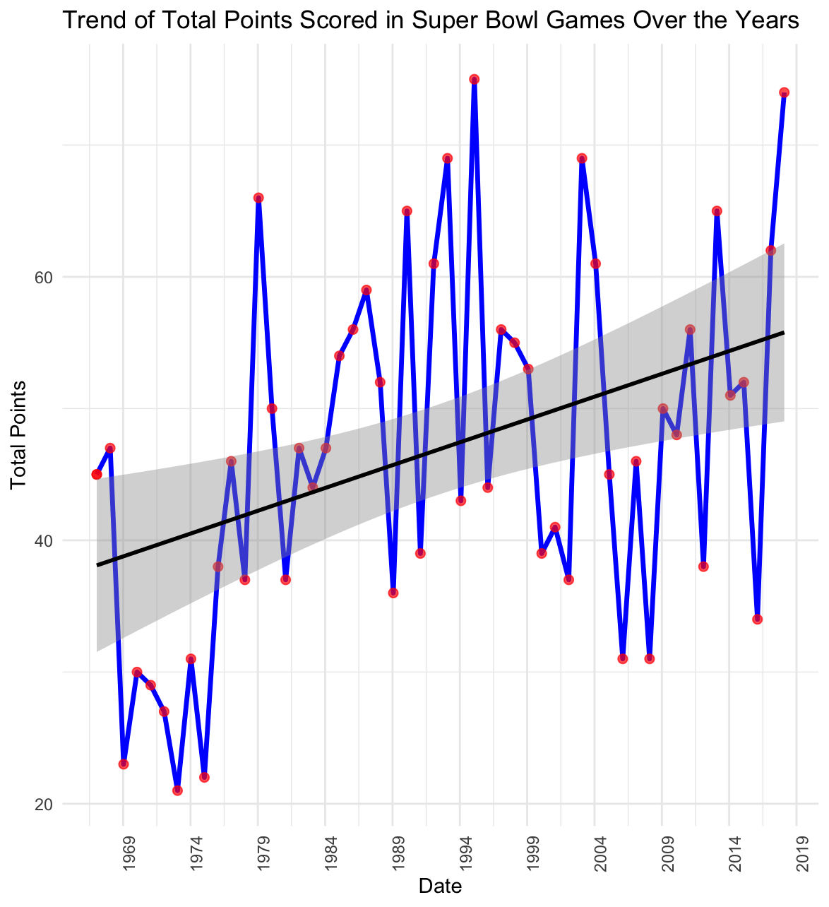
Visualization:
Notes:
Leyton

Slide 8
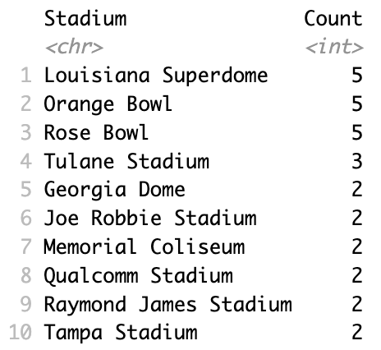
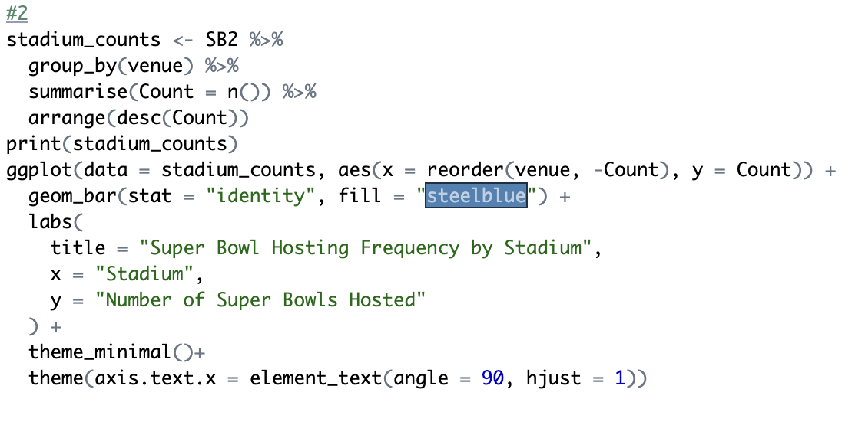
Query 2: Which stadiums have hosted the most SuperBowl games?
Notes:
Leyton

Slide 9
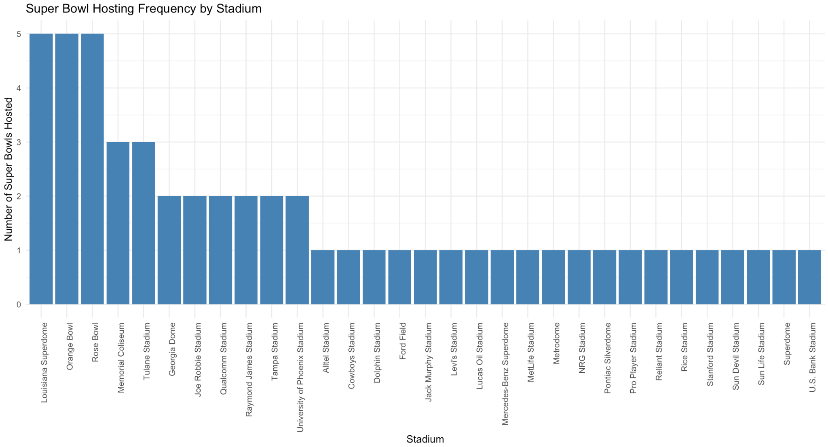
Visualization #2
Notes:
Leyton

Slide 10

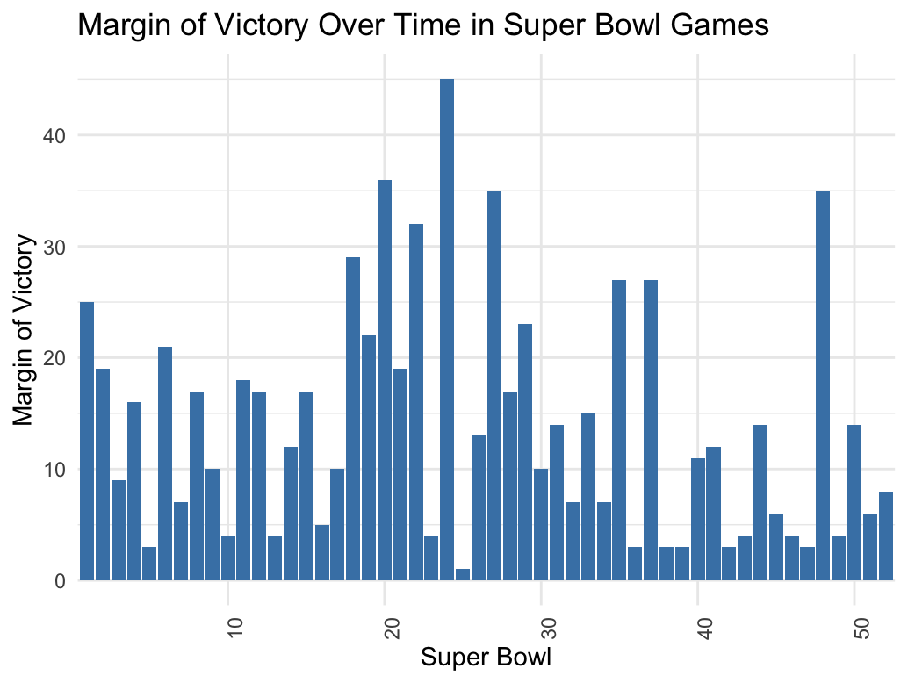
Query #3: What is the average margin of victory in Super Bowl games over time?
Notes:
Leyton

Slide 11
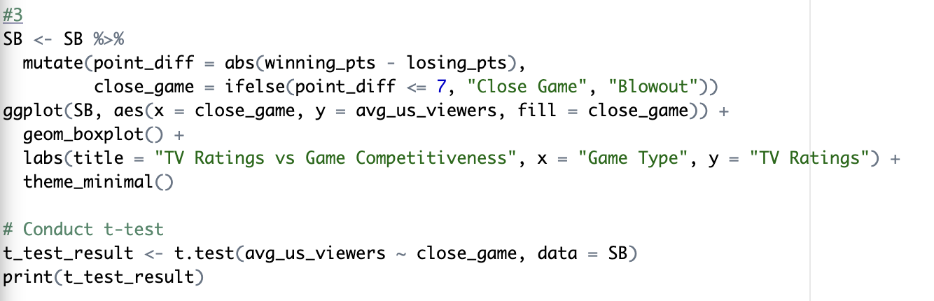
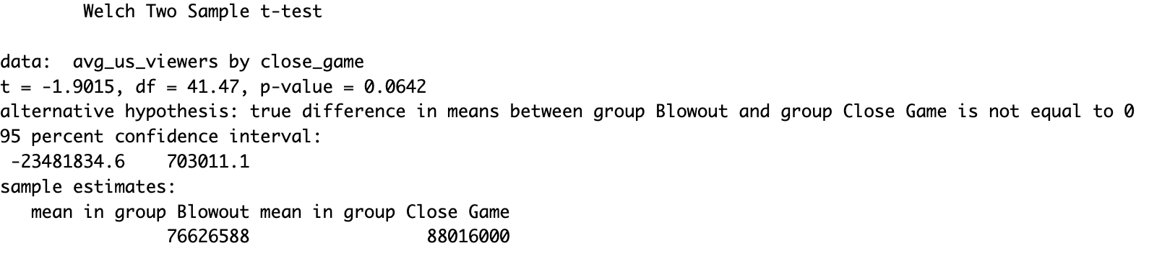
Query #4: #relationship between tv ratings and super bowl outcome (close games vs blowouts)
T = -1.9015 suggests that the mean TV ratings for “blowout” games is lower than those for “close games”
Notes:
We determined a blowout would be any game that was won by 7 or more points, and inversely for close games

Slide 12
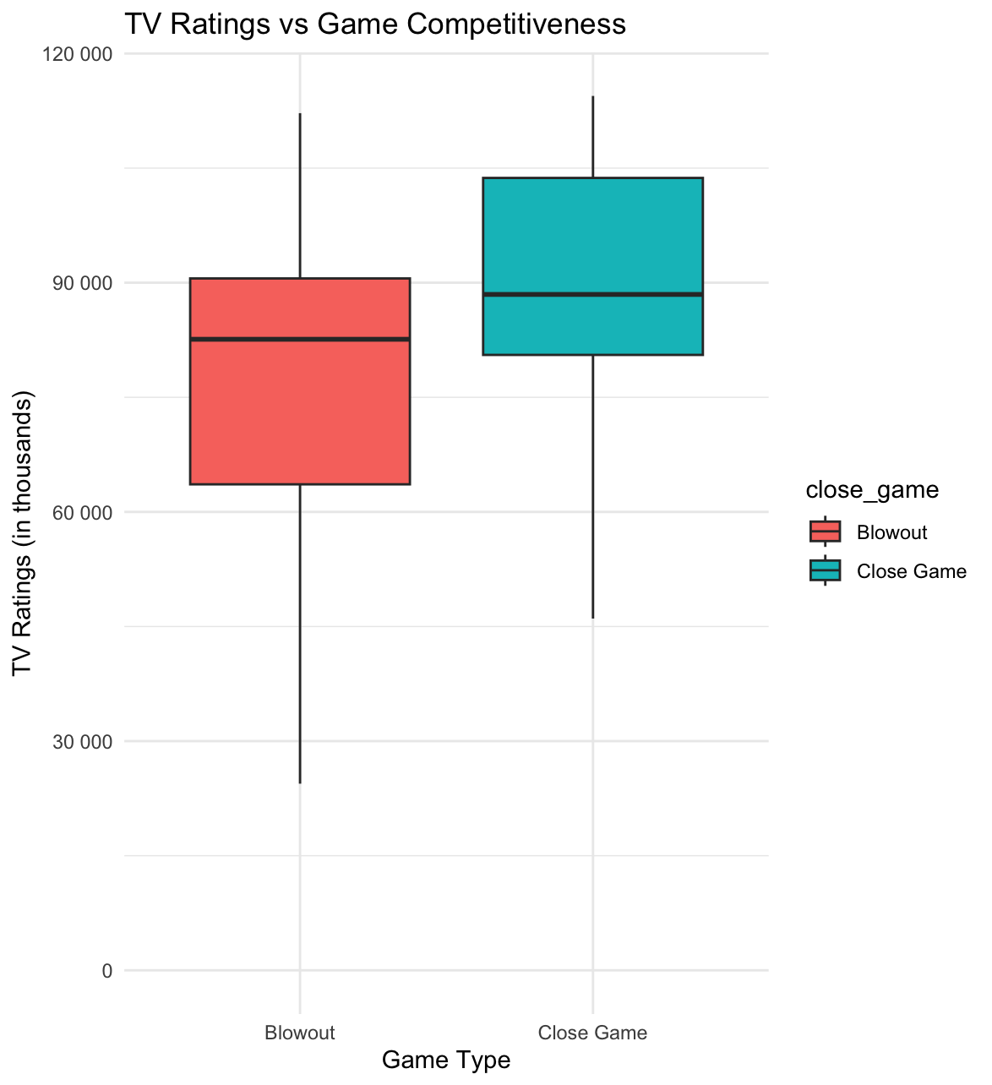
Visualization:

Slide 13
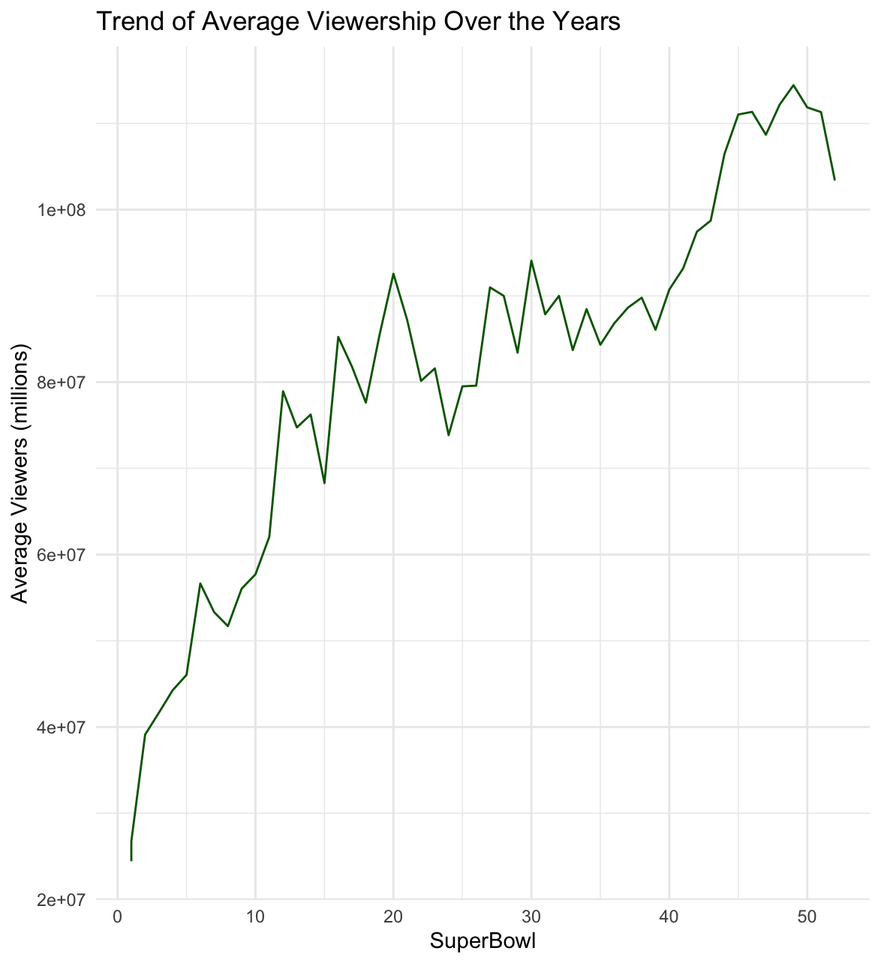
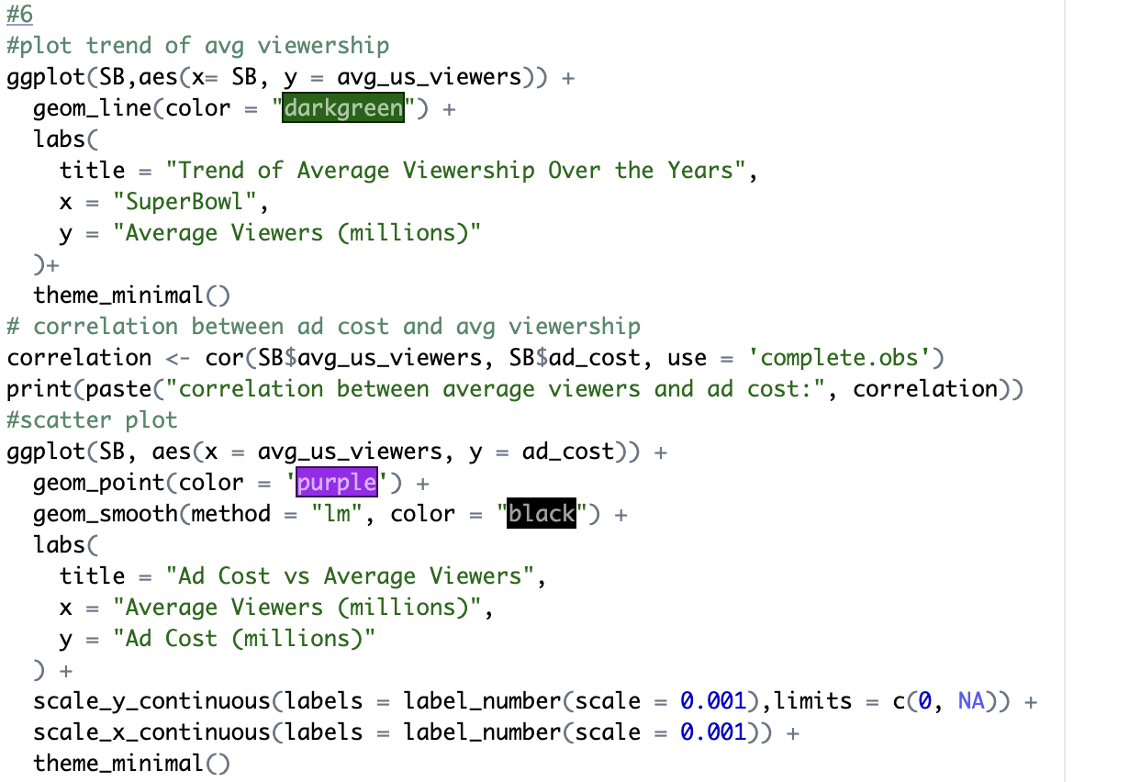
Query #5: What is the trend in TV viewership (average viewers) over the years, and how does it correlate with ad cost?

Slide 14
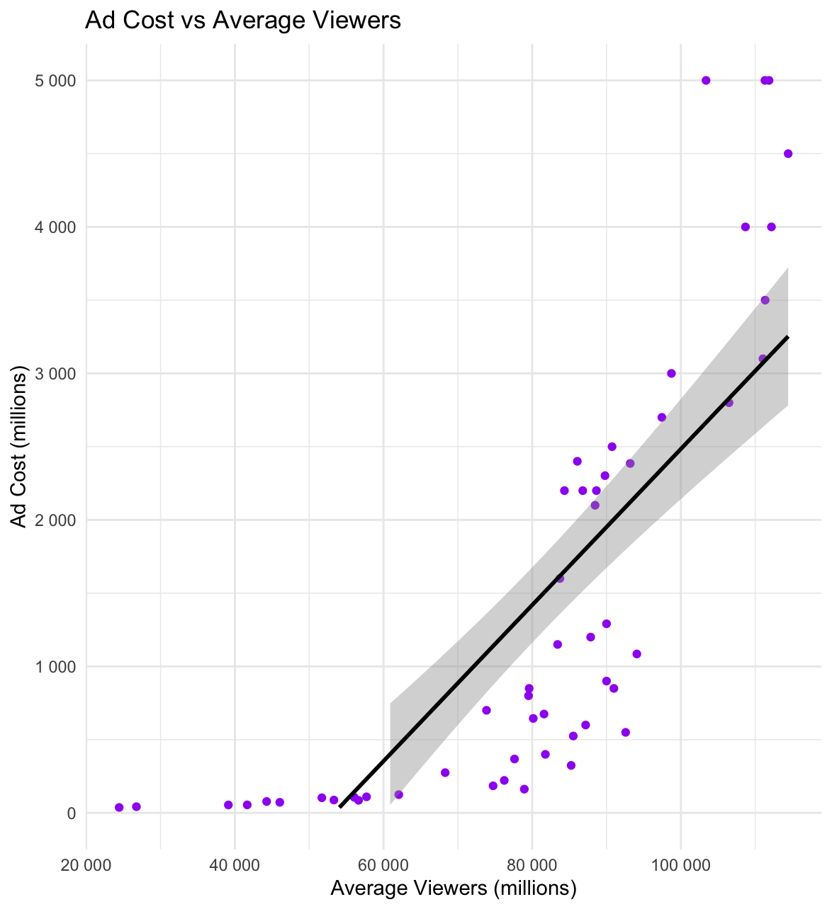

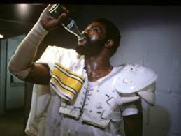
Visualization:

Slide 15
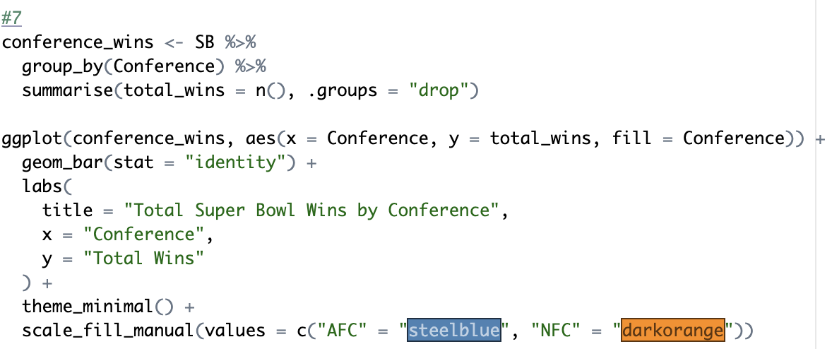
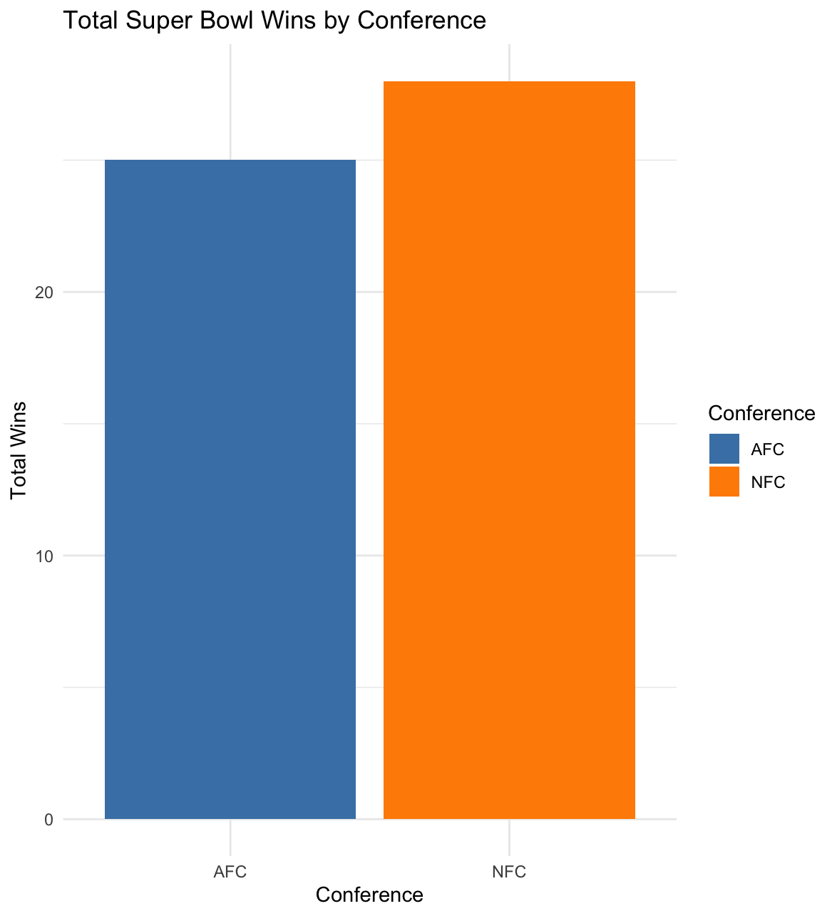
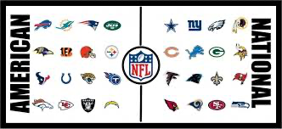
Query #6: How does super bowl wins vary by conference (NFC v AFC)

Slide 16
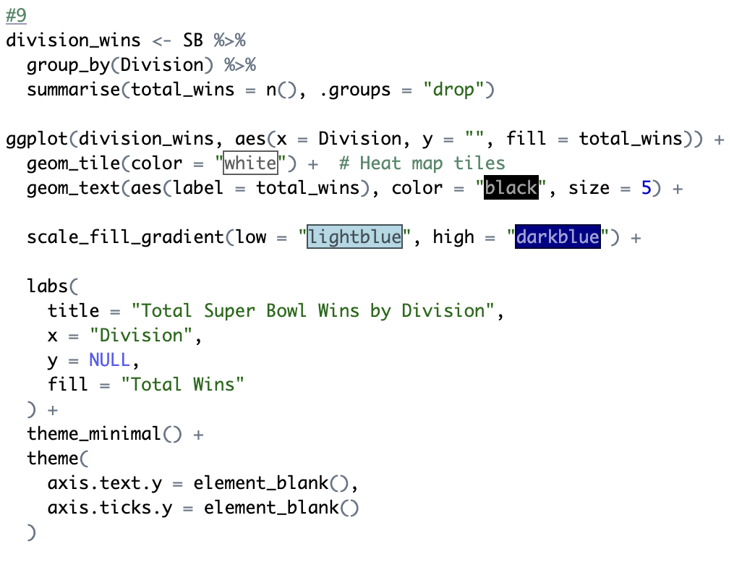
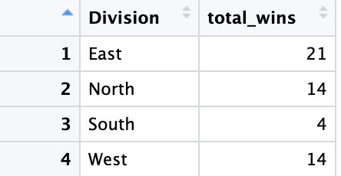
Query #7: Total Super Bowl Wins by Division

Slide 17
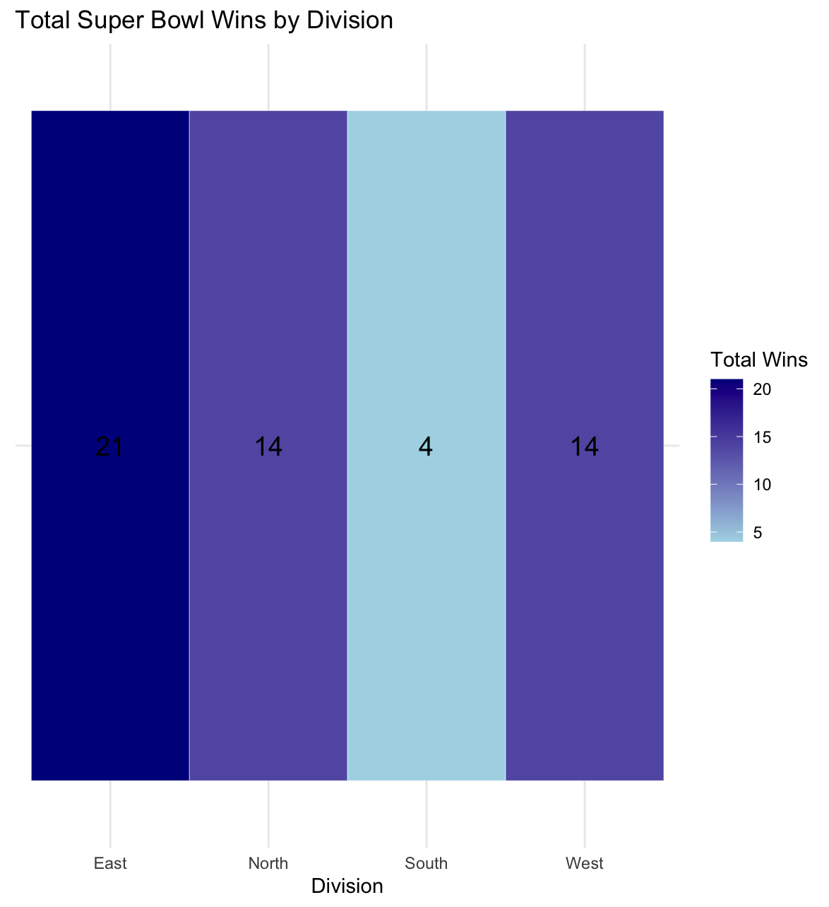
Visualization:

Slide 18
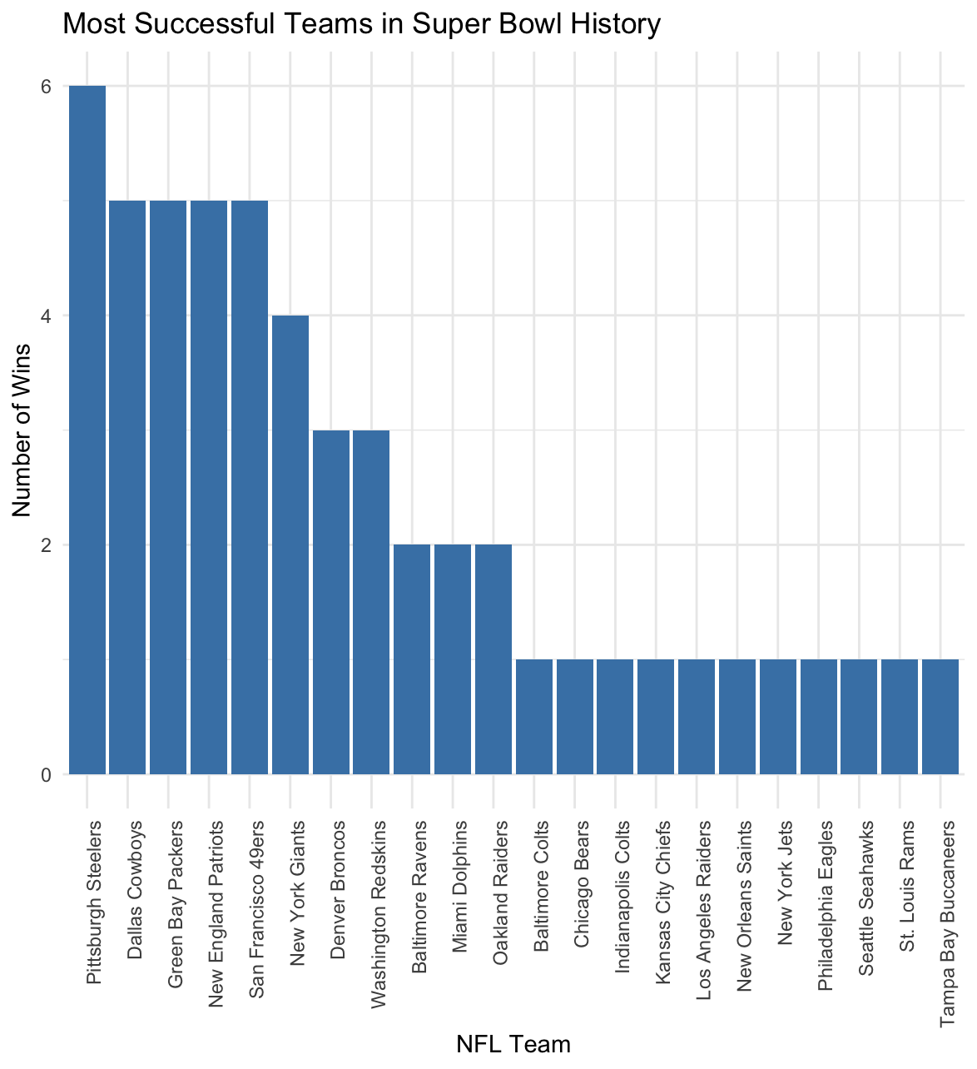
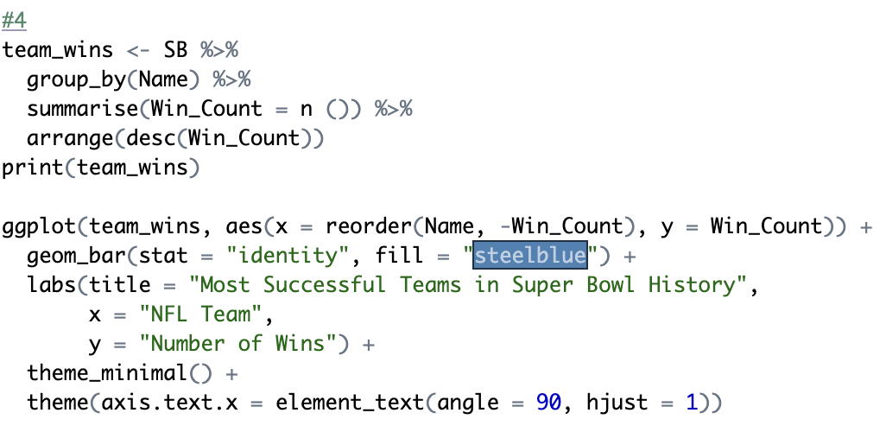
Query #8: Which teams have won the most Super Bowl titles, and how has their performance varied over time?

Slide 19
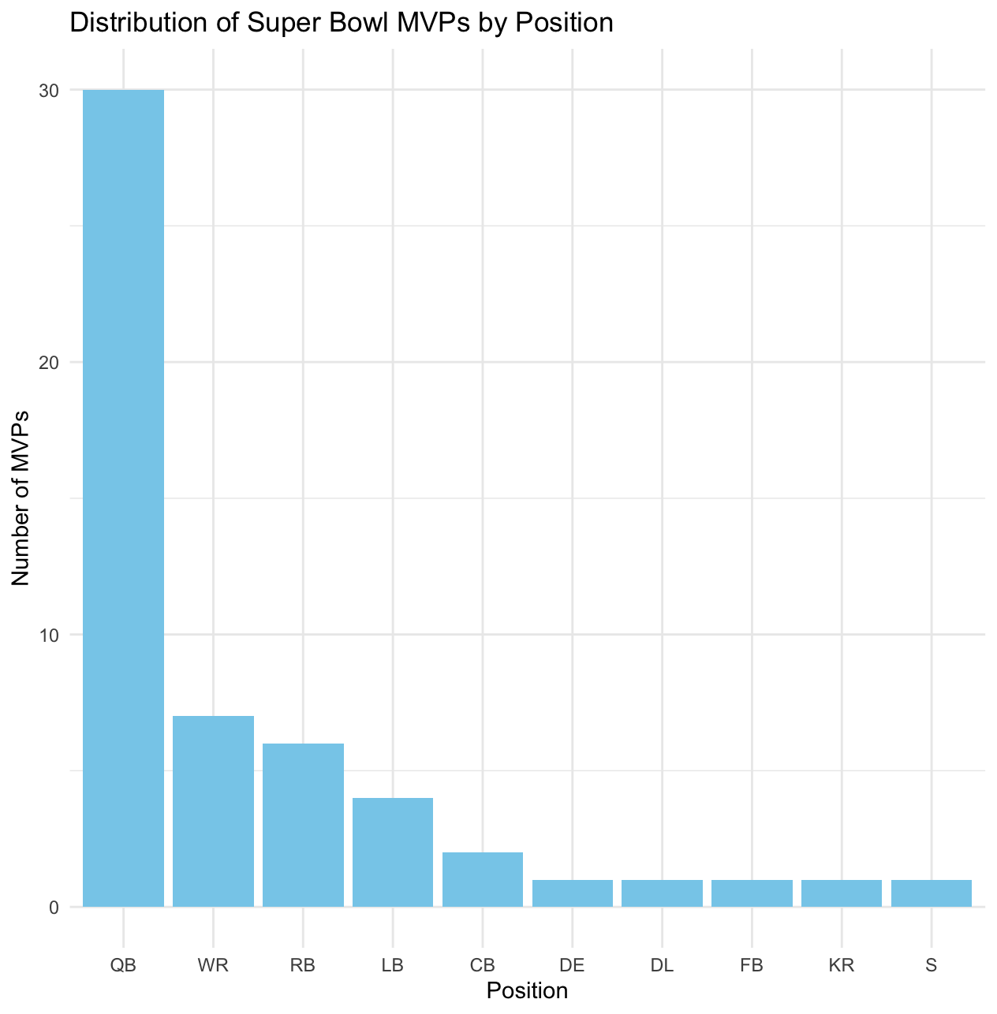
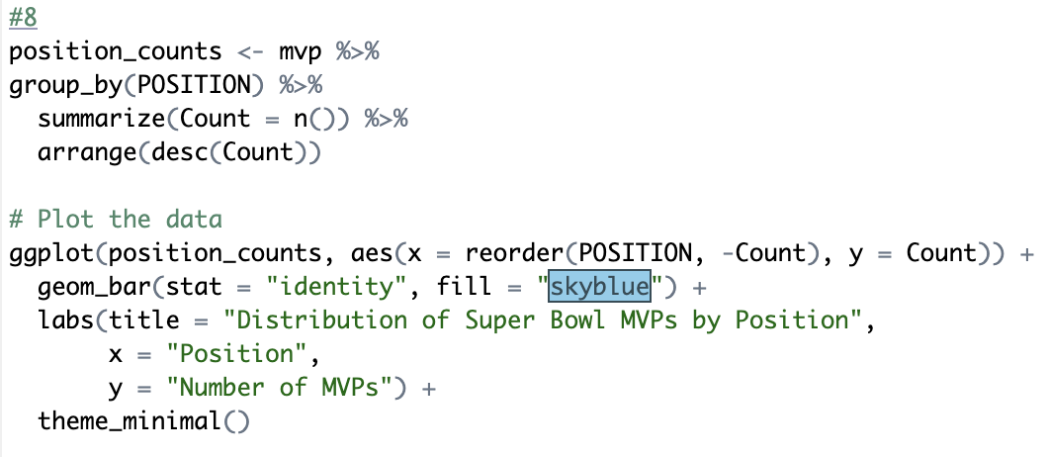
Query #9: What position is most likely to win super bowl MVP

Slide 20
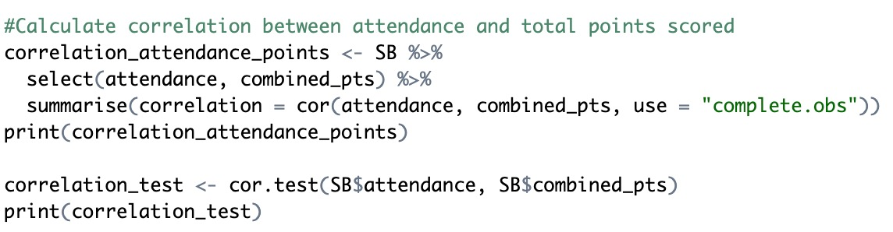
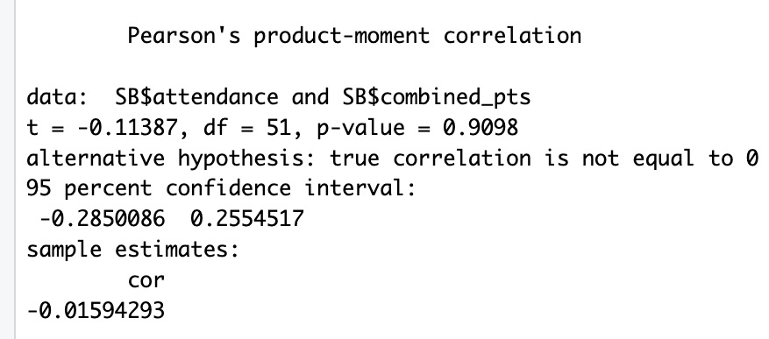
Query #10: Is the correlation between total points scored and attendance?
Correlation coefficient: -0.01594
Indicates almost no linear correlation
P-value: 0.9098
Non statistically significant

Slide 21
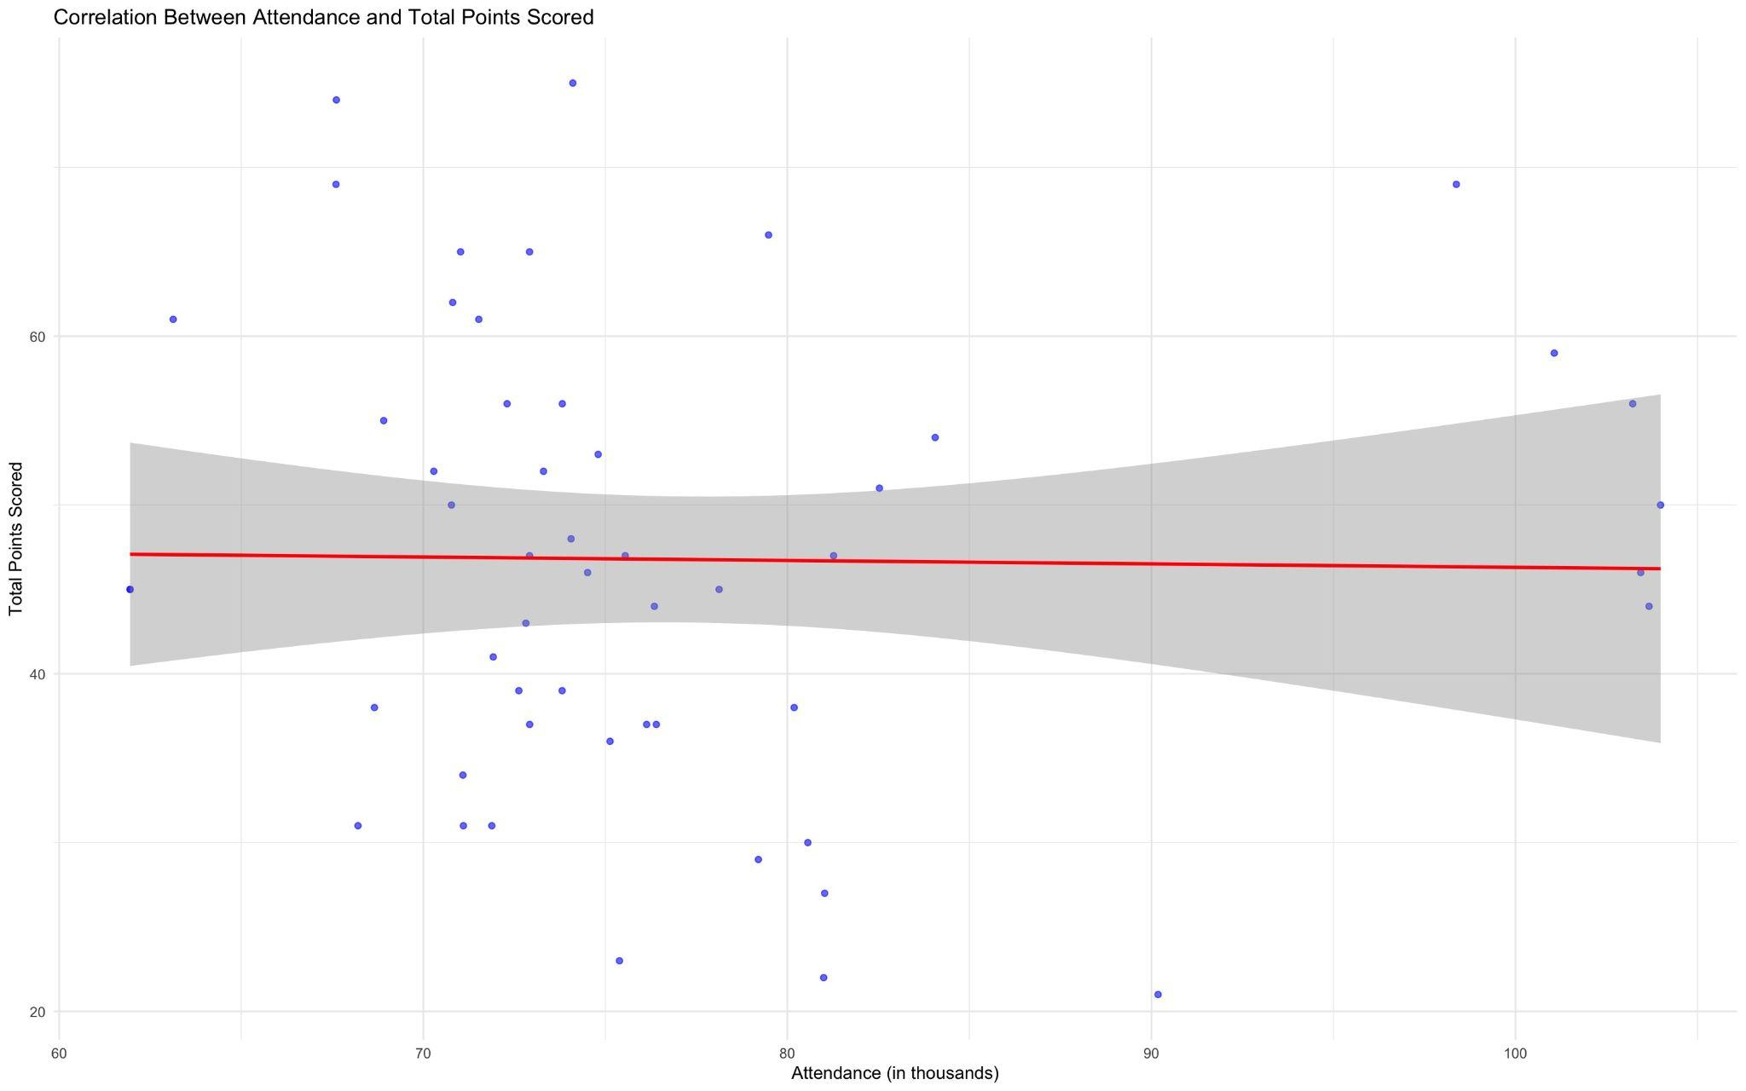
Visualization:
No Correlation

Slide 22
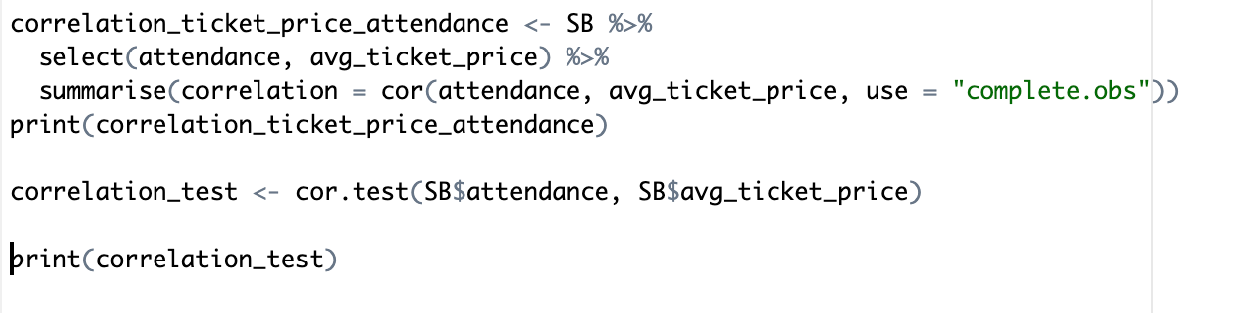
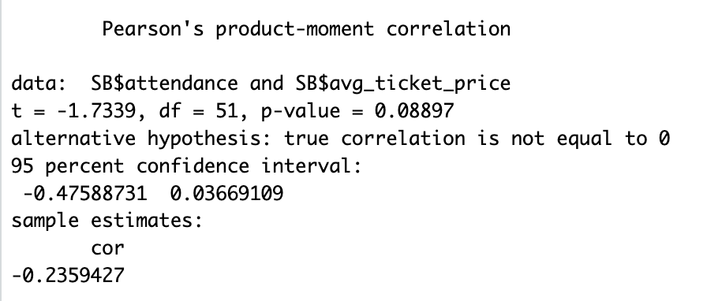
Query #11: Is there a correlation between ticket prices and attendance?
Correlation Coefficient: -0.2359
Weak and Negative correlation
P-value of 0.08897 shows the correlation could be due to chance

Slide 23
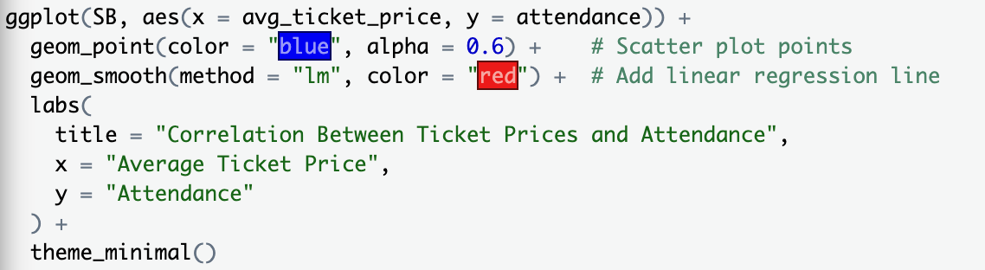
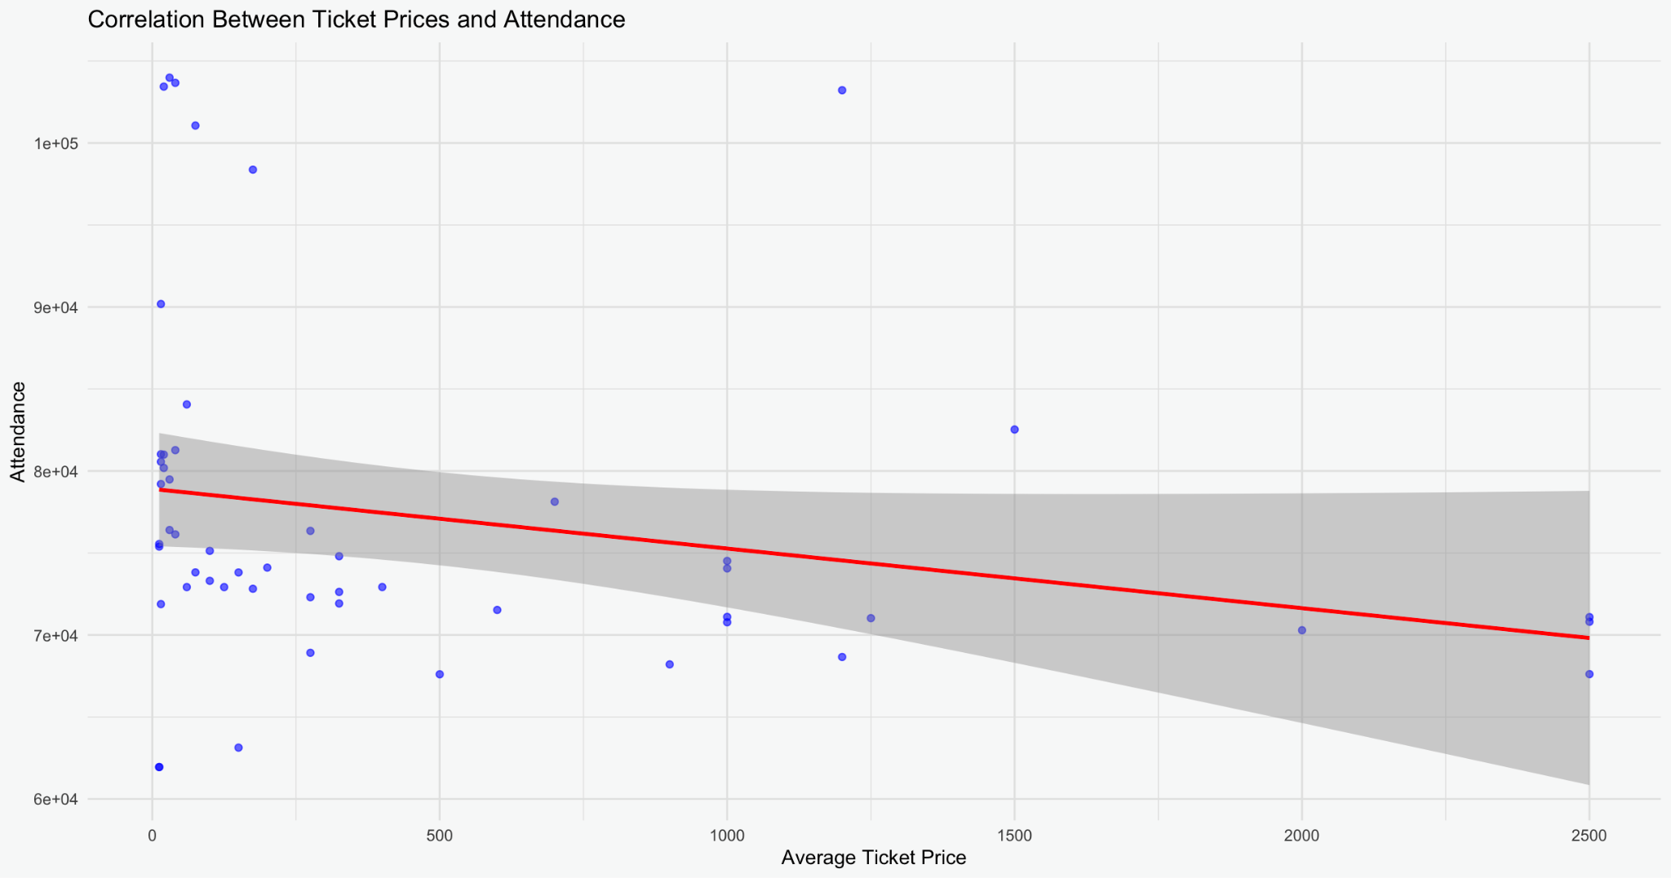
Visualization:

Slide 24
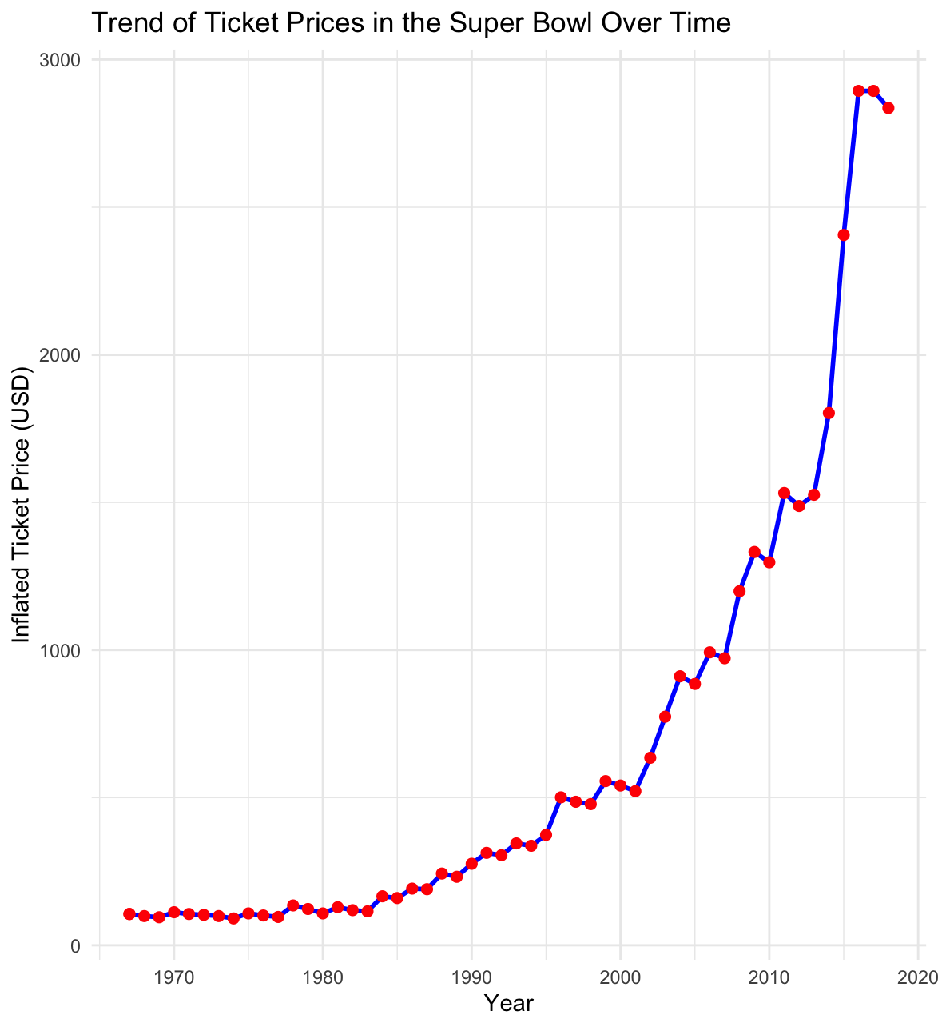
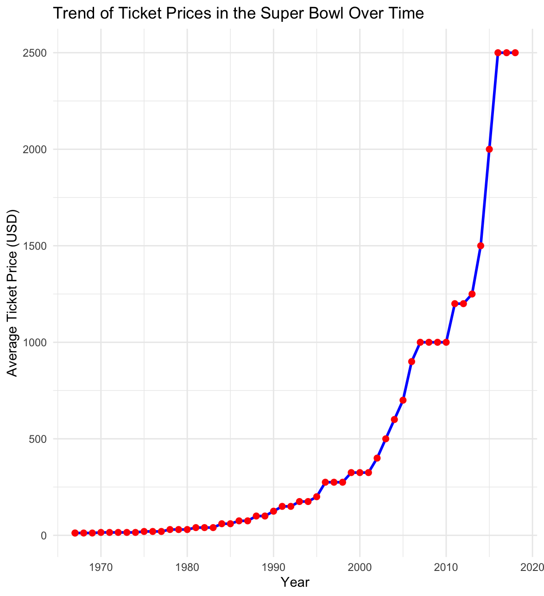
Query #12: Trend of Ticket Prices in the Super Bowl over time

Slide 25
Conclusion
There is very little correlation that determines attendance at Super Bowls, this could be attributed to the idea that people will always attend the Super Bowl, regardless of game outcome or ticket price.
Total points scored has increased, which could be attributed to the evolution of football
Key insights:
Financial analysis: strong correlation between avg. viewership & ad cost
Performance analysis: the importance of the quarterback in Super Bowls

Slide 26

Thank you!

